Slide 1
ChatGPT APIs
February 2025 IPD Week
#NetAcadIPD
http:/cs.co/IPDFeb2025
NetAcad.com

Slide 2

Agenda
1
New Course Releases
IPD & Educator Resources
Product Updates and Announcements
Marketing Updates
Platform Updates
Digital Badges and Certificates
Sunset Legacy
Planned Downtimes
2
3
4
5
6
7
8

Slide 3
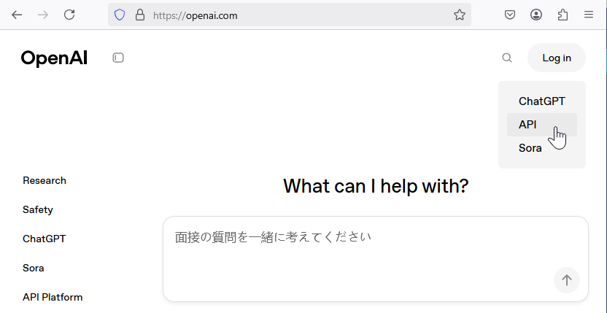
Get started with OpenAI Platform
API access via OpenAI Platform
Also includes the Playground
Must have an account
Account is separate from ChatGPT
No free credits
Must credit the account – min $5
Usage cost varies by service and model
Can explore API reference without paying
Log in to “API”

Slide 4
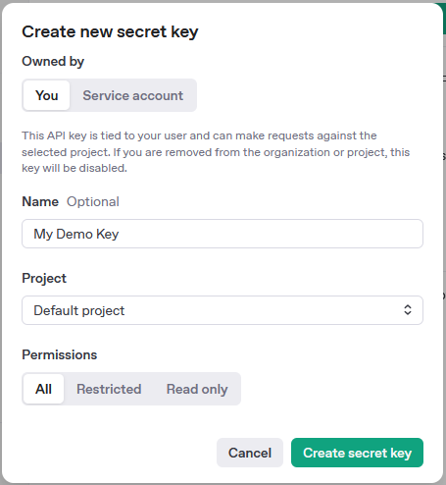
Authentication
Generate an API key from OpenAI account dashboard
API keys are generated per project
Format for authorization header: "Authorization": "Bearer YOUR_API_KEY“
Keep confidential
Store securely; avoid hard-coding it
When using SDK, use env variable

Slide 5
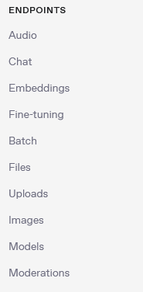
API documentation
Basic API endpoints:
Audio: Speech-to-text processing
Chat: Conversational AI, “completions”
Embeddings: Vector text representations
Fine-tuning: Custom model training
Batch: Multi-request processing
Files: File storage management
Uploads: File uploading
Images: Image generation/editing
Models: Model information
Moderations: Content safety checks

Slide 6
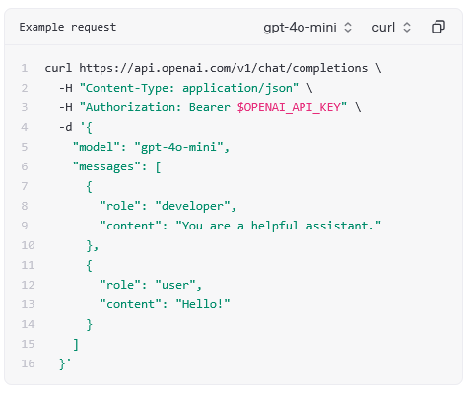
Create chat completion API call
POST https://api.openai.com/v1/chat/completions
Content-Type: application/json
Auth: Bearer token
Model to be used: gpt-4o, gpt-3.5-turbo, etc.
Messages:
user
developer (aka system)
assistant

Slide 7
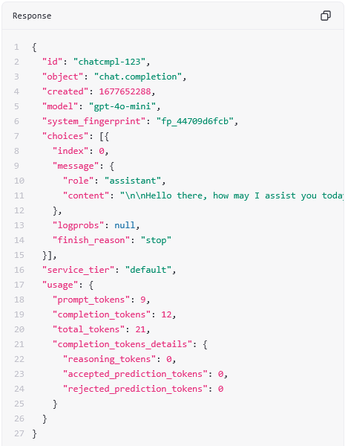
Chat completion response
Choices – the model response content:
May have multiple “choices” if requested
“content” is the actual response text
finish_reason: stop (natural), length, content_filter
Model
Usage – how many tokens were consumed in and out
Can calculate cost

Slide 8
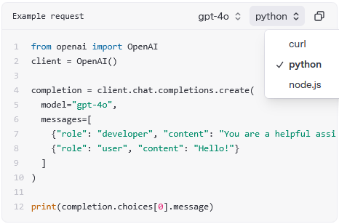
Using python SDK
Curl samples for lower-level coding (python requests)
JavaScript and Python are also available
Python uses the Python SDK
Install with: pip install openai
The auth key is taken from env variable OPENAI_API_KEY

Slide 9

DEMO
Notes:
Demo ideas:
IPD Resources – show IPD Week page vs individual item
Educator Resources – 3 different ways
Course Resources – highlighting Errata, S&S (for example: CCST IT Support Essentials), Instructor slides, etc. May also want to open a class and show were they can find them.
Modules – how to find them and maybe show the new module landing page
Legal documents: Membership Guide, etc.
Marketing materials – banner, logo, etc.

Slide 10


